Slide 1
StayMatch
Prathima S R (Project Manager) Kritika Agarwal (Lead Developer) Akshat (Jenkins Admin) Rahul Mendes (Lead BA) Daulet (Product Owner)
Shubham (DBA)
Kritika (Jira Admin) Daulet (Lead QA)
Dhruv Chamaria (QA)

Slide 2
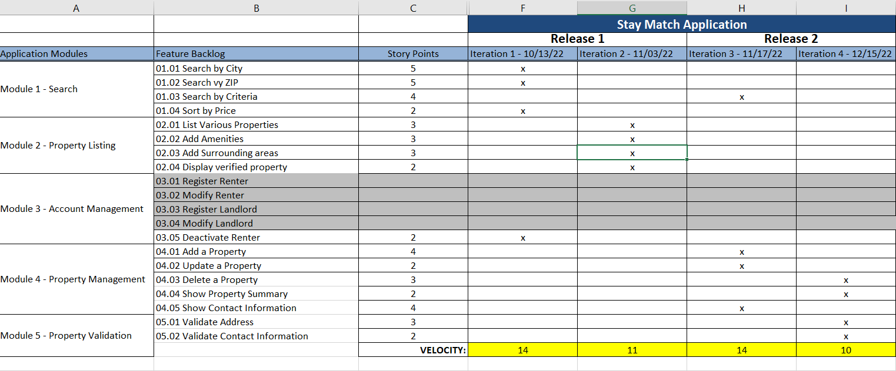
Road Map
(Prathima Seethalam Radhakrishna)

Slide 3
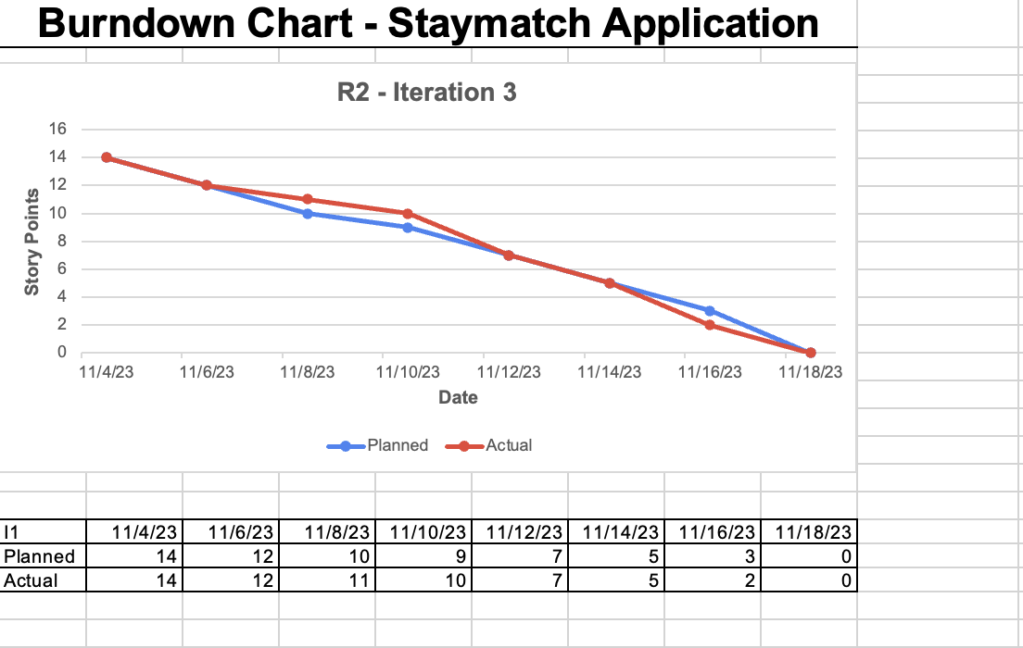
Burn Down Chart
(Kritika Agrawal)

Slide 4
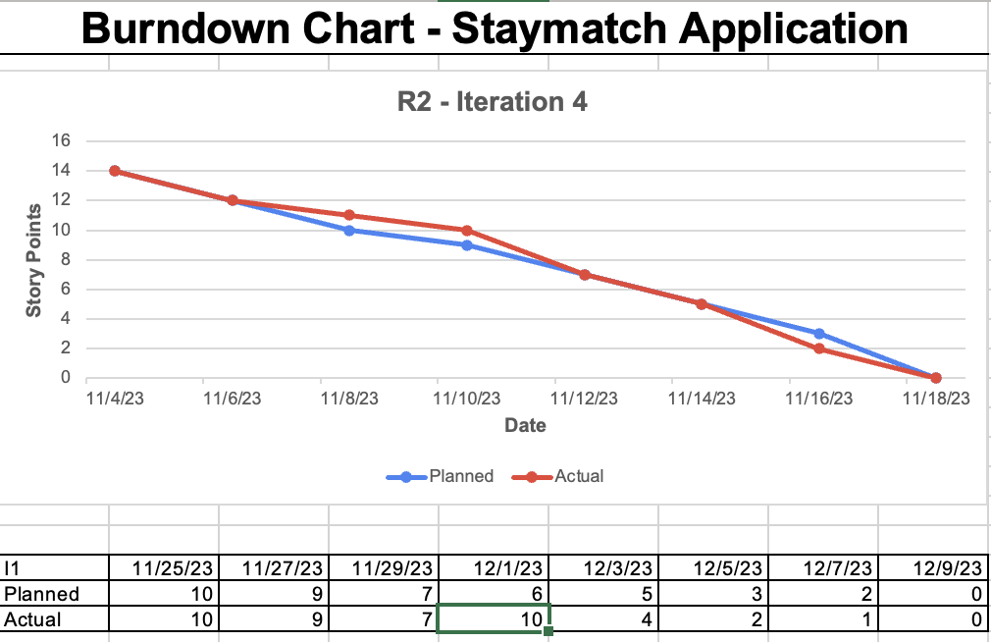
Burn Down Chart
(Kritika Agrawal)

Slide 5
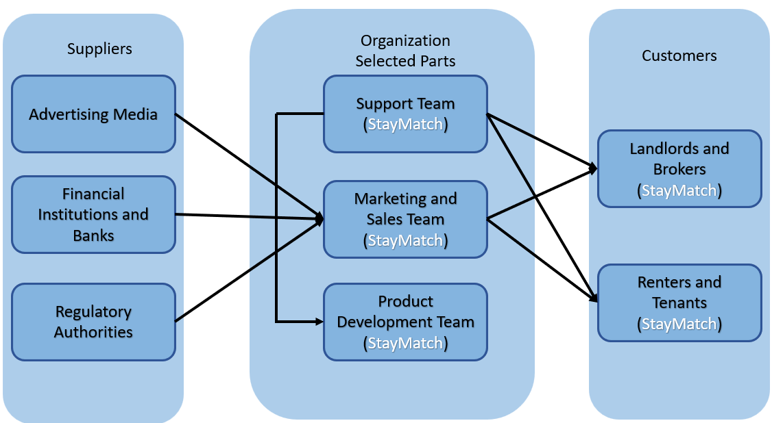
BRM Diagram (Shubham Mishra)
Suppliers
Organization selected parts
Customers

Slide 6
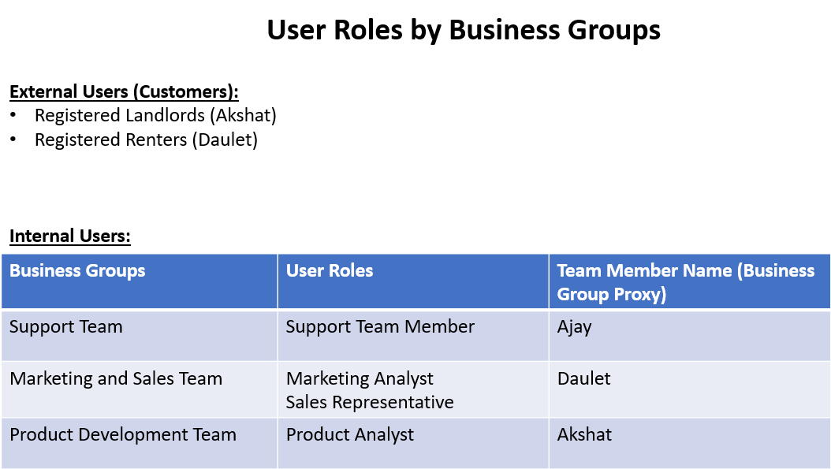

Slide 7
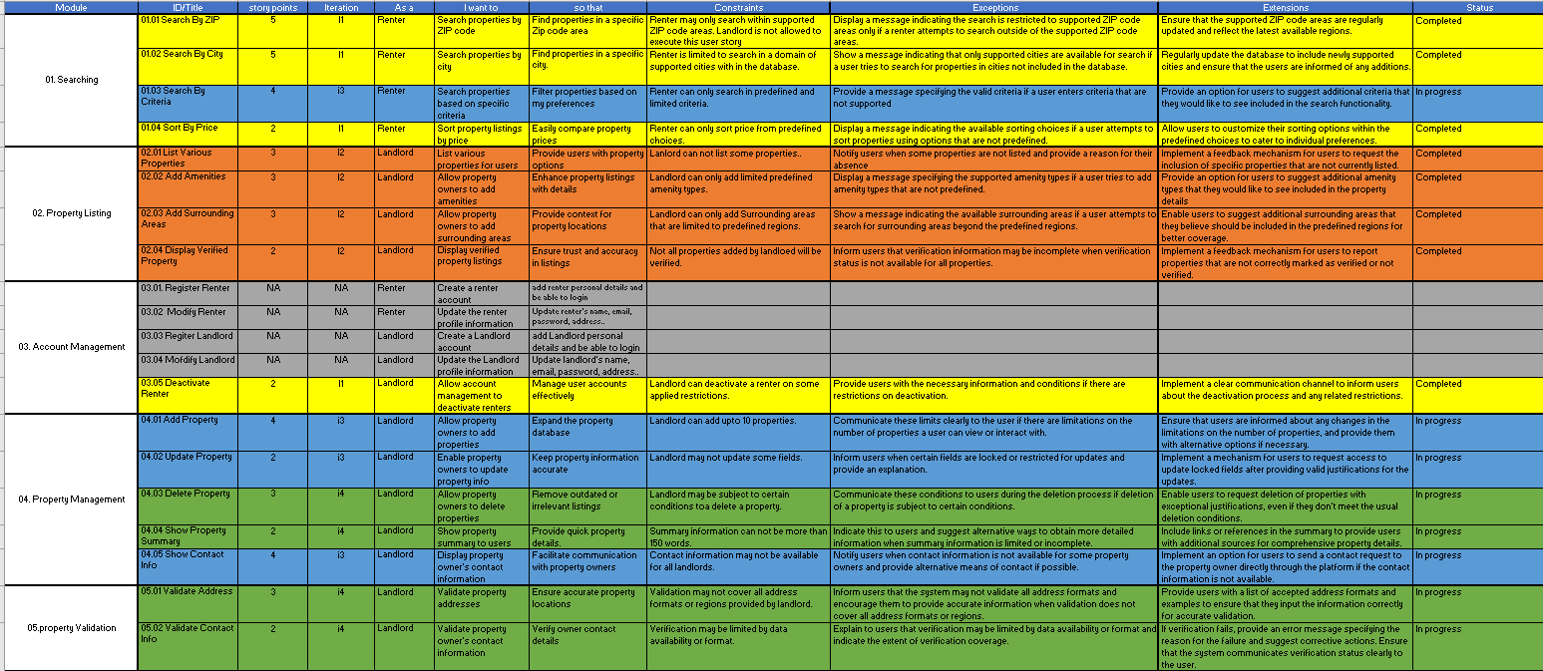
User Stories
(Ajay Kumar)

Slide 8
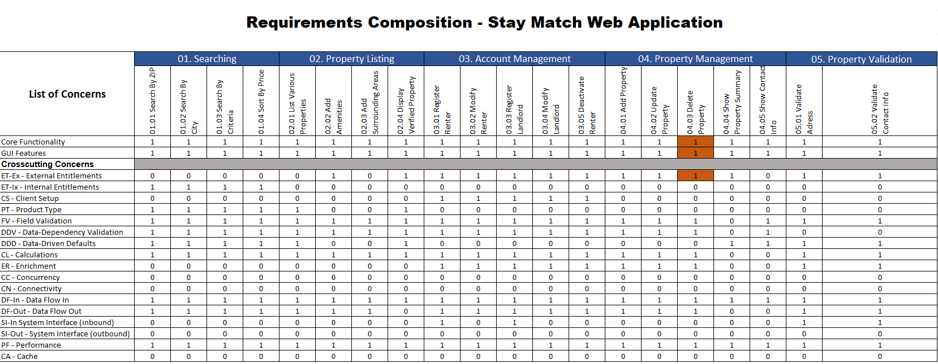
Functional Test
(Dhruv Chamaria)

Slide 9
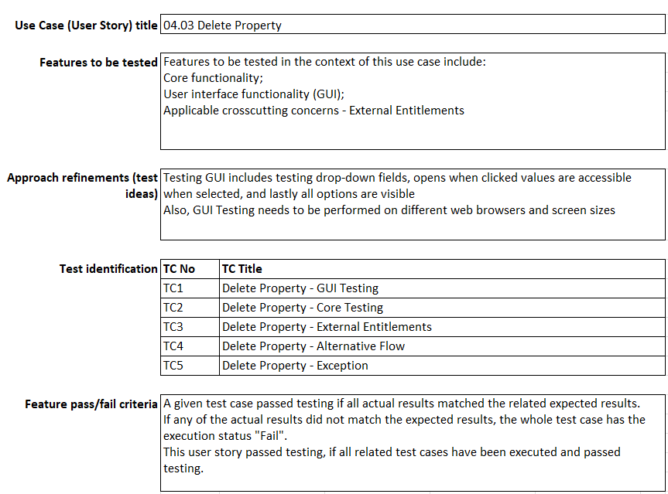
Test Design
(Dhruv Chamaria)

Slide 10
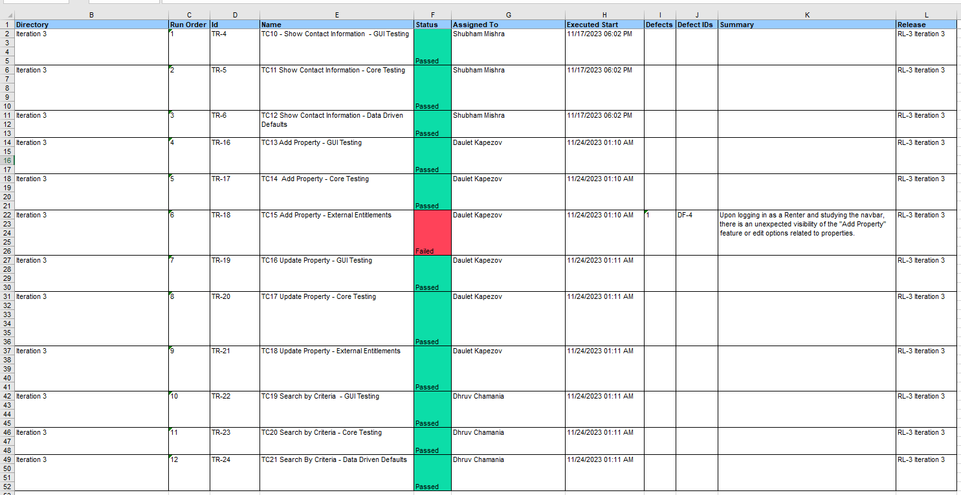
Test execution Log (I3)
(Daulet Kapezov)

Slide 11
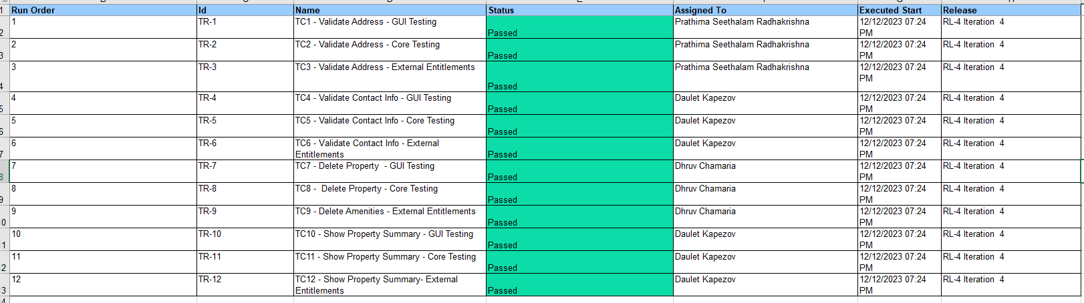
Test execution Log (I4)
(Daulet Kapezov)

Slide 12
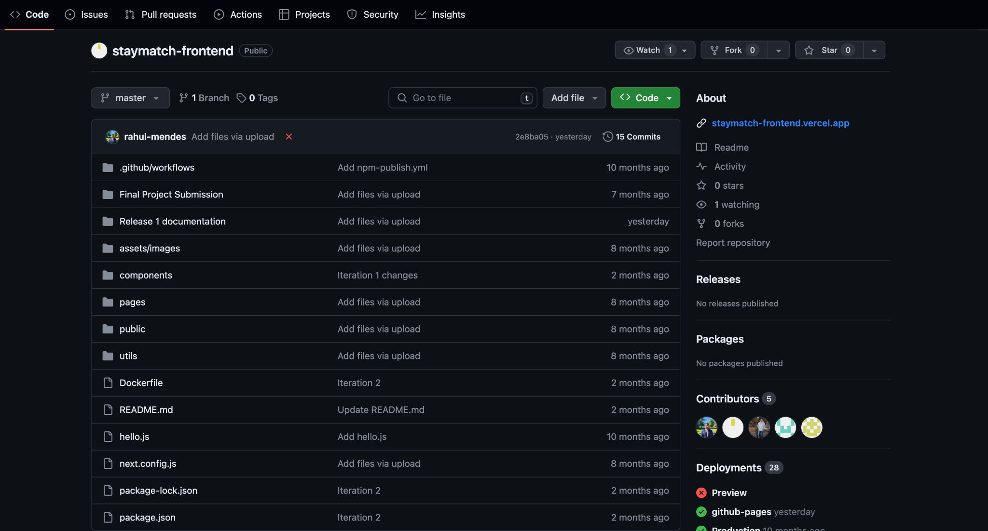
Git Hub Folder
(Ajay Kumar)

Slide 13
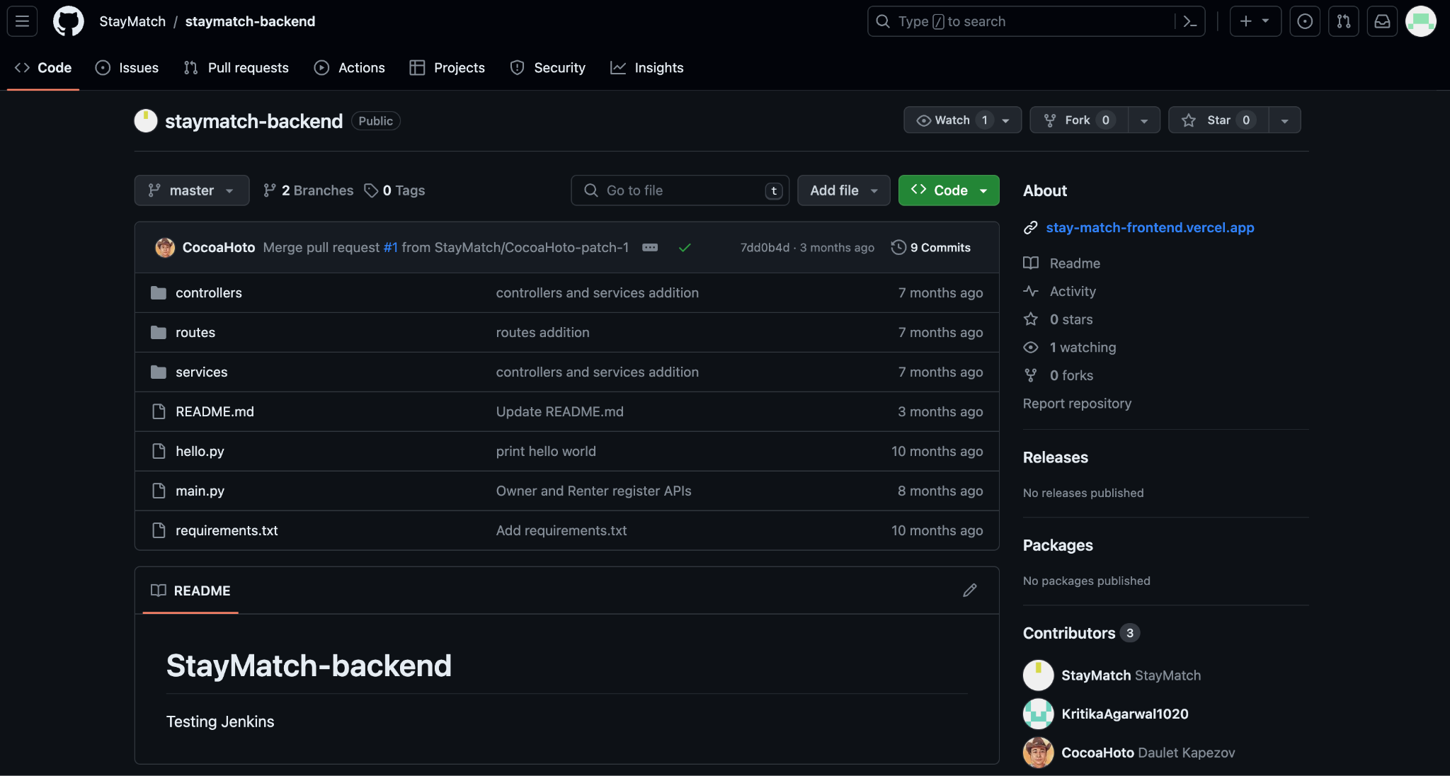
Git Hub Folder
(Ajay Kumar)

Slide 14
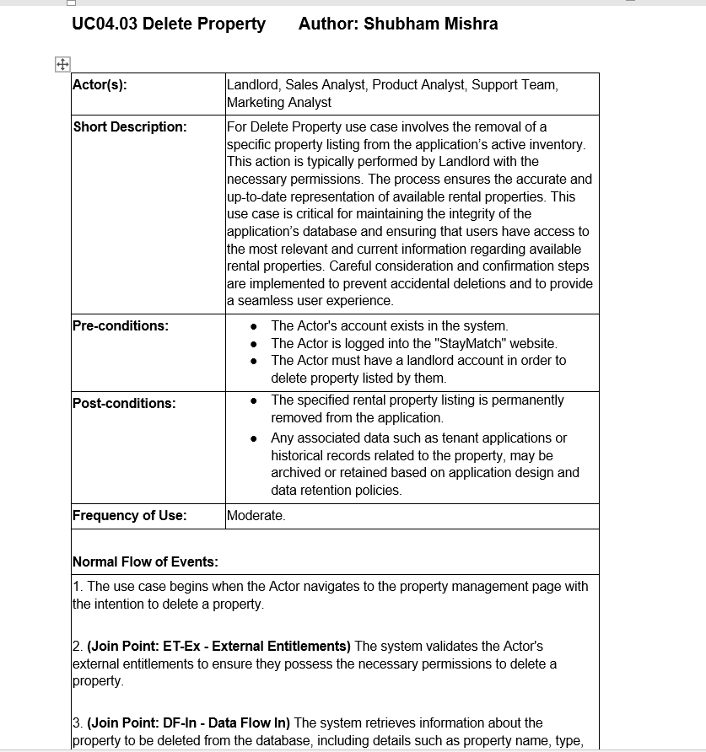
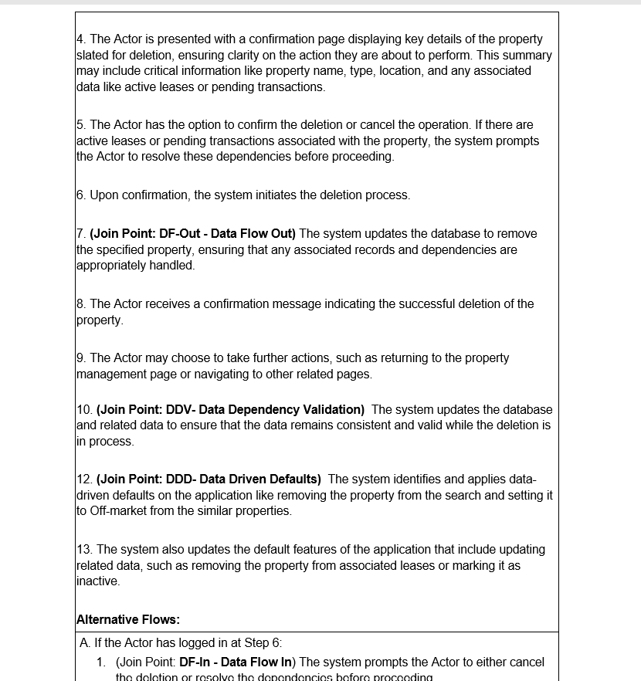
Use case specification : Delete Property (Shubham Mishra)

Slide 15
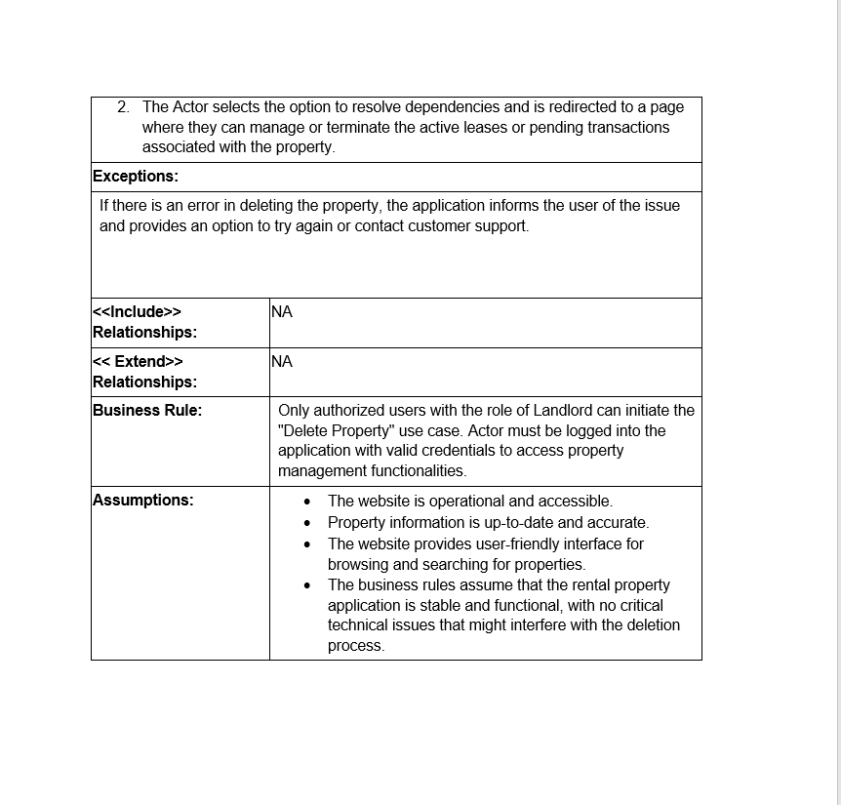
Use case specification : Delete Property
(Shubham Mishra)

Slide 16
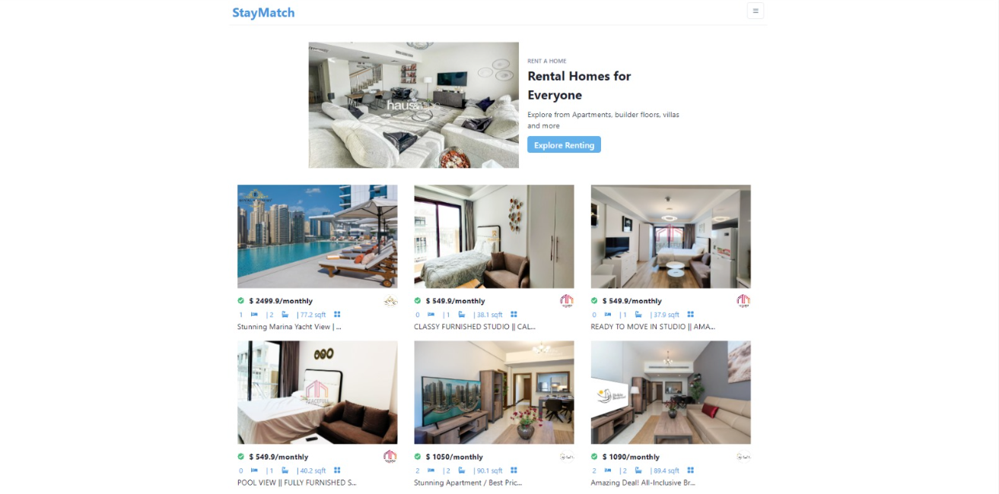
Recorded Demo
(Prathima Seethalam Radhakrishna)

Slide 17
Thank You

